Slide 1

DAYANANDA SAGAR ACADEMY OF TECHNOLOGY & MANAGEMENT
(An Autonomous Institute under VTU)
Project Final Review
2024-25
Title of the Project: “Prediction and Classification of Cardiac Arrhythmia Using
Machine Learning”
Guide Name: Prof Bhavya V Student Names and USN: Assistant professor Shabaz Pasha 1DT21CS137 Computer Science and Engineering Raghuveer K J 1DT22CS413
DSATM Renukaprasad K R 1DT22CS414
Vikram S 1DT22CS416

Slide 2
DAYANANDA SAGAR ACADEMY OF TECHNOLOGY & MANAGEMENT
(An Autonomous Institute under VTU)
Agenda:
Introduction
Motivation
Literature Review
Problem statement
Objectives
Methodology
Use Case Diagram
Data Flow Diagram
Classification
Hardware Specifications
Software Specifications
Sample Outputs
Conclusion
Bibliography

Slide 3
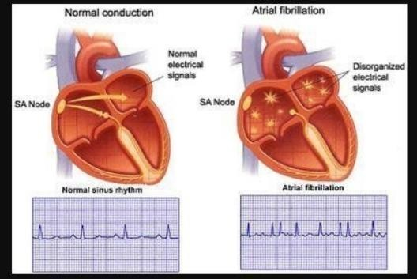
DAYANANDA SAGAR ACADEMY OF TECHNOLOGY & MANAGEMENT
(An Autonomous Institute under VTU)
Introduction:
The diagnosis of numerous cardiac abnormalities such as Arrhythmia can be signified using ECG
Cardiac Arrhythmia is a condition in which the heartbeat is irregular, either it is too fast or too slow, Many types of Arrhythmias have no symptoms.

Slide 4
DAYANANDA SAGAR ACADEMY OF TECHNOLOGY & MANAGEMENT
(An Autonomous Institute under VTU)
Introduction:
Although arrhythmias can affect individuals of any age, they are more prevalent among older populations. Any disruption to the heart's electrical impulses, responsible for orchestrating its rhythmic contractions, can precipitate arrhythmias.
In individuals with healthy hearts, a resting heart rate typically falls within the range of 60-100 beats per minute.
In the absence of external triggers like substance abuse or electric shocks, a healthy individual typically doesn't experience long-term arrhythmias

Slide 5
DAYANANDA SAGAR ACADEMY OF TECHNOLOGY & MANAGEMENT
(An Autonomous Institute under VTU)
Motivation:
Early detection of cardiac arrhythmia is essential to reduce health risks and improve patient outcomes.
Manual ECG analysis in traditional diagnosis is time-consuming and prone to errors.
Machine learning enables accurate and automated classification of arrhythmias through ECG data analysis.
The framework improves early intervention, reduces clinician workload, and supports scalable healthcare solutions.

Slide 6
DAYANANDA SAGAR ACADEMY OF TECHNOLOGY & MANAGEMENT
(An Autonomous Institute under VTU)
Literature Review:
Sl.No | Paper title and authors | Year | Observation
1. | P. Patel, J. Wilson, and R. Kim, “ECG Signal Classification Using Transfer Learning,” Journal of Healthcare Informatics Research, vol. 7, no. 1, pp. 45–60 | 2023 | This study explores various machine learning algorithms for the detection of cardiac arrhythmias using electrocardiogram (ECG) data.
2. | M. Taylor, J. Lee, and S. Chen, “Ensemble Learning for Cardiac Arrhythmia Detection,” Journal of Artificial Intelligence in Medicine, vol. 112, pp. 1–10 | 2023 | Propose an ensemble learning framework that combines multiple machine learning classifiers to enhance the detection of cardiac arrhythmias
3. | S.Thompson, M. Brown, and L. White, “Real-Time ECG Classification Using Deep Learning,” International Journal of Cardiology, vol. 150, no. 4, pp. 567–580 | 2023 | Real-time ECG classification system that leverages deep learning techniques to identify various types of cardiac arrhythmias
4. | D. Green, A. Black, and K. Harris, “Hybrid Machine Learning Model for Arrhythmia Prediction,” Journal of Medical Systems, vol. 46, no. 2, pp. 1–12 | 2022 | A hybrid machine learning model that combines decision trees and neural networks for predicting cardiac arrhythmias

Slide 7
DAYANANDA SAGAR ACADEMY OF TECHNOLOGY & MANAGEMENT
(An Autonomous Institute under VTU)
Problem statement :
Detection and classification of cardiac arrhythmia for early diagnosis and treatment.
Accurate identification of abnormal heart rhythms enables clinicians to initiate appropriate therapies promptly.
This approach enhances patient outcomes, reduces the risk of stroke and heart failure, and supports continuous cardiac monitoring.

Slide 8
DAYANANDA SAGAR ACADEMY OF TECHNOLOGY & MANAGEMENT
(An Autonomous Institute under VTU)
Objectives:
To develop an efficient machine learning model for the early prediction and classification of cardiac arrhythmia.
To analyze ECG signals for accurate detection of different types of arrhythmia.
To preprocess and clean the dataset to ensure high-quality input for the model.

Slide 9
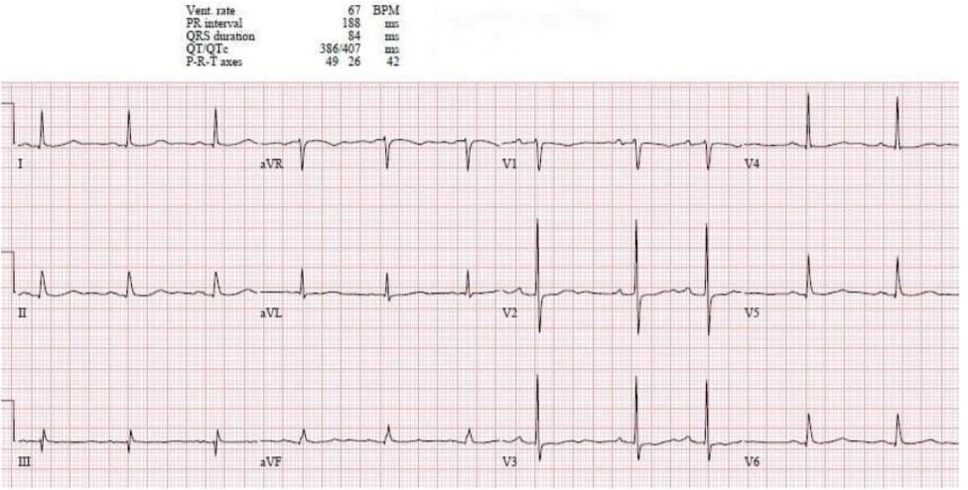
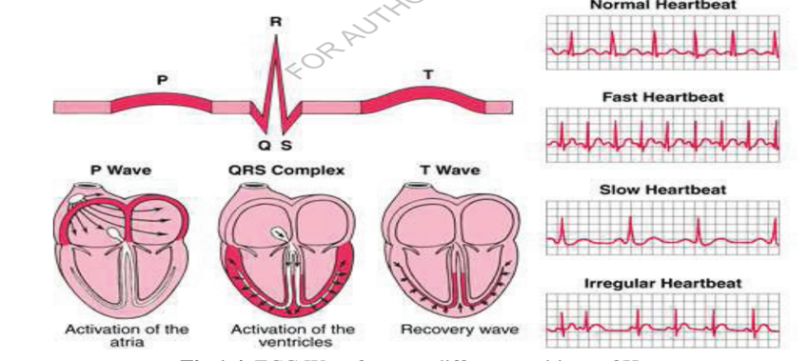
DAYANANDA SAGAR ACADEMY OF TECHNOLOGY & MANAGEMENT
(An Autonomous Institute under VTU)
Methodology:
1. Data Collection:Collecting the ECG report data from websites or hospitals.
2. Importing Libraries : To perform data preprocessing in Python, we need to utilize specific predefined libraries.
3. Importing the Dataset : Incorporate the datasets compiled for our machine learning endeavor into the project's codebase..
4. Handling Missing data : If our dataset contains any missing values, it can significantly impact the performance of our machine-learning model.

Slide 10
DAYANANDA SAGAR ACADEMY OF TECHNOLOGY & MANAGEMENT
(An Autonomous Institute under VTU)
Methodology:
5. Encoding Categorical data : Categorical variables such as Gender, Name, and diagnosis in our dataset can impede machine learning models that operate solely on numerical data, necessitating encoding for compatibility
6. Feature Extraction : Feature extraction involves converting raw data into numerical representations while retaining essential information, leading to improved performance compared to using raw data directly in machine learning.
7. Splitting the Dataset into the Training set and Test set: In the process of data preprocessing in machine learning, a pivotal step involves partitioning the dataset into a training set and a test set.
8. Prediction and Accuracy: Accuracy in classification problems indicates the proportion of correct predictions made by a model, offering insight into its performance.

Slide 11
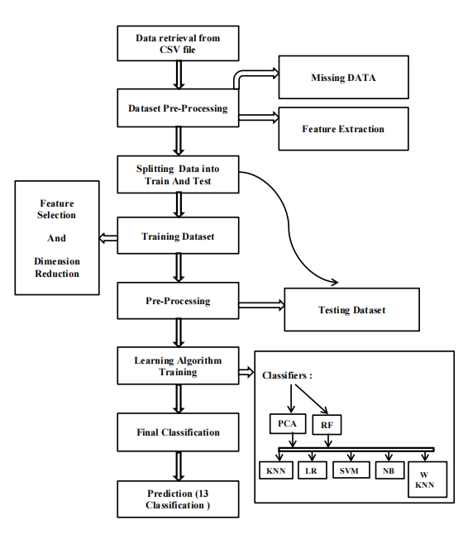
DAYANANDA SAGAR ACADEMY OF TECHNOLOGY & MANAGEMENT
(An Autonomous Institute under VTU)
DATA FLOW DIAGRAM:
Data "flow" across an information system is graphically
represented by a data flow diagram, which illustrates various
process components. To offer a general overview of the system
without going into considerable depth.
A data flow diagram is shown in the Figure, and it indicates the
different types of data that data input into the system, data output
from the system, data flow through the system, and data storage.
It does not include information on process time or whether
activities will execute sequentially or simultaneously.
First, from csv file, the data is taken, and then the dataset is
processed. Filtering the measured signals is part of data
processing since real ECG data is noisy and tainted with artifacts
such as electrocardiography signals caused by breathing and
chest movement.

Slide 12
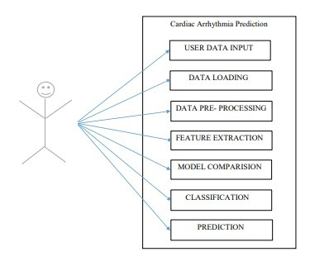
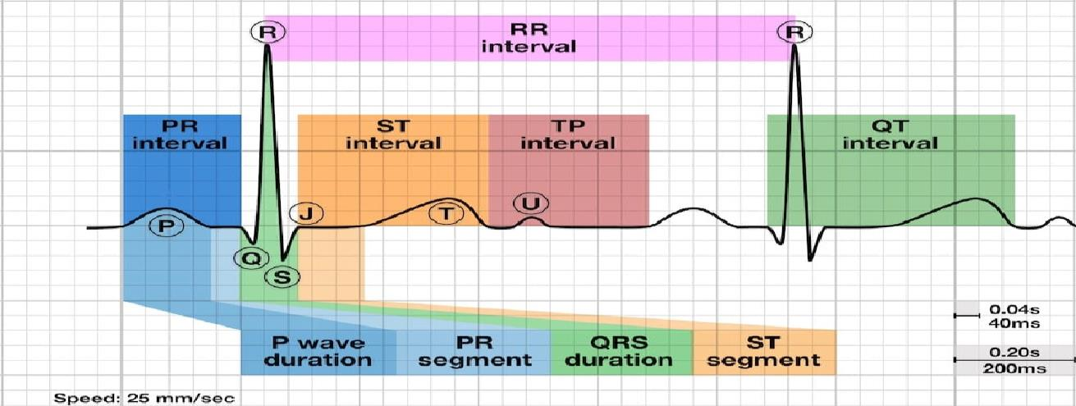
DAYANANDA SAGAR ACADEMY OF TECHNOLOGY & MANAGEMENT
(An Autonomous Institute under VTU)
USE CASE DIAGRAM:A use case diagram is a graphical depiction of a user's possible interactions with a system. A use case diagram shows various use cases and different types of users the system has and will often be accompanied by other types of diagrams as well.
Electrocardiogram

Slide 13
DAYANANDA SAGAR ACADEMY OF TECHNOLOGY & MANAGEMENT
(An Autonomous Institute under VTU)
Classification:
Wave Feature | Arrhythmia Type
Absent/abnormal P-wave | Atrial fibrillation (AF)
Prolonged PR interval | First-degree AV block
Wide QRS complex | Bundle branch blocks, Ventricular tachycardia (VT)
ST-segment elevation | Myocardial infarction (MI)
Inverted T-wave | Ischemia

Slide 14
DAYANANDA SAGAR ACADEMY OF TECHNOLOGY & MANAGEMENT
(An Autonomous Institute under VTU)
Hardware Specifications:
Processor: 64-bit 2.8GHz.
Ram: 8GB or higher.
Hard Disk: 500GB.
Input device: Standard Keyboard and Mouse.
Compact Disk: 650Mb.
Output device: High-Resolution Monitor.
Software Specifications:
Operating system: Windows .
Coding language: python or R language.
IDE: Anaconda Navigator Jupyter Notebook or R Studio.
Libraries: Matplotlib, Seaborn, Numpy, Pandas, SK learn Open CV OS.

Slide 15
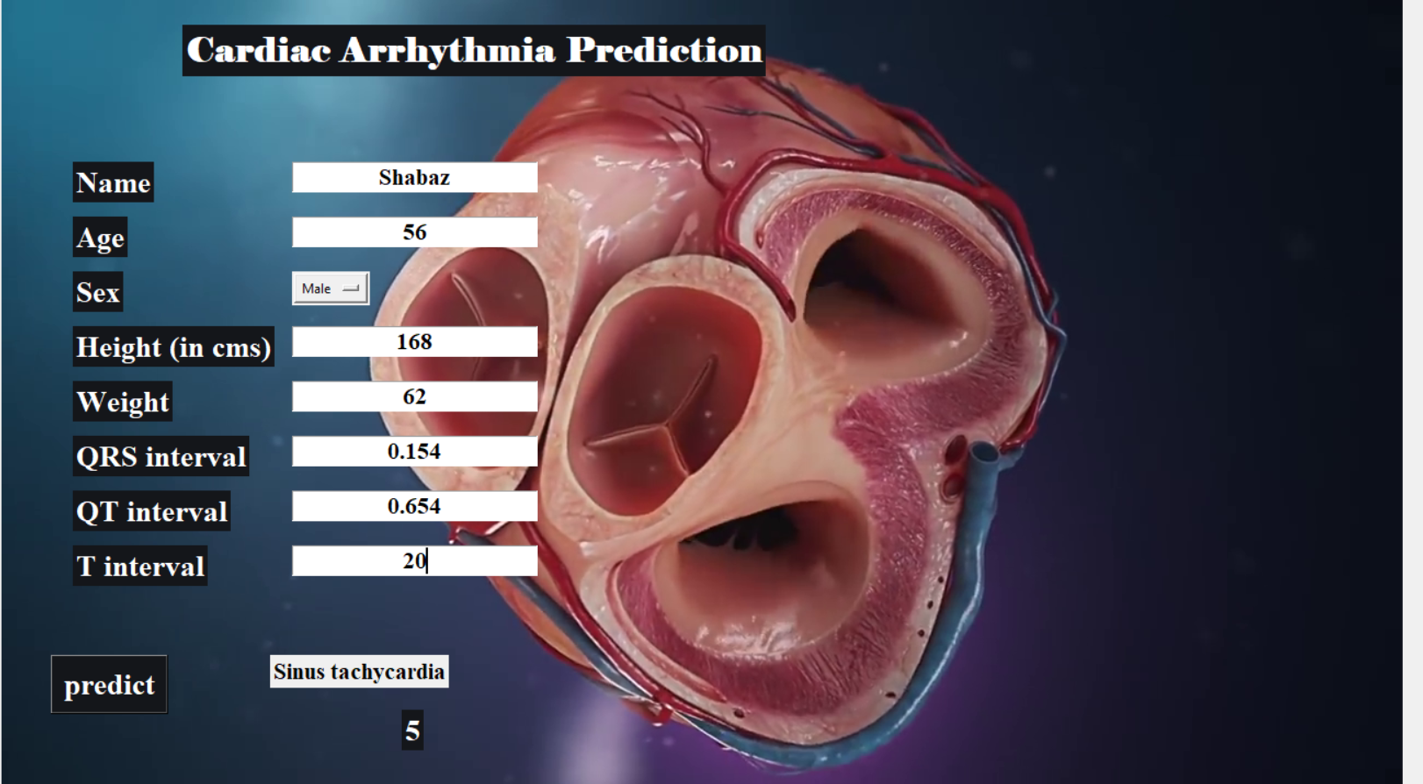
DAYANANDA SAGAR ACADEMY OF TECHNOLOGY & MANAGEMENT
(An Autonomous Institute under VTU)

Slide 16
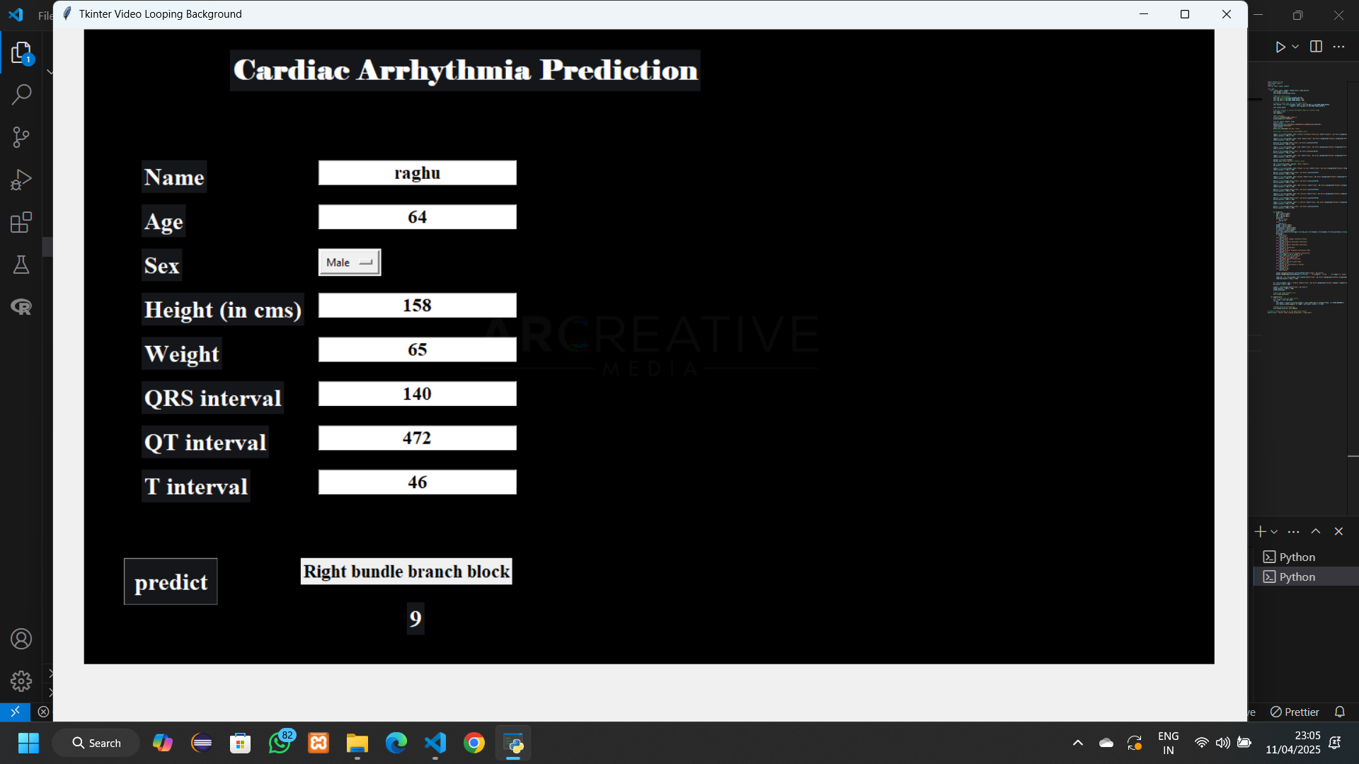
DAYANANDA SAGAR ACADEMY OF TECHNOLOGY & MANAGEMENT
(An Autonomous Institute under VTU)

Slide 17
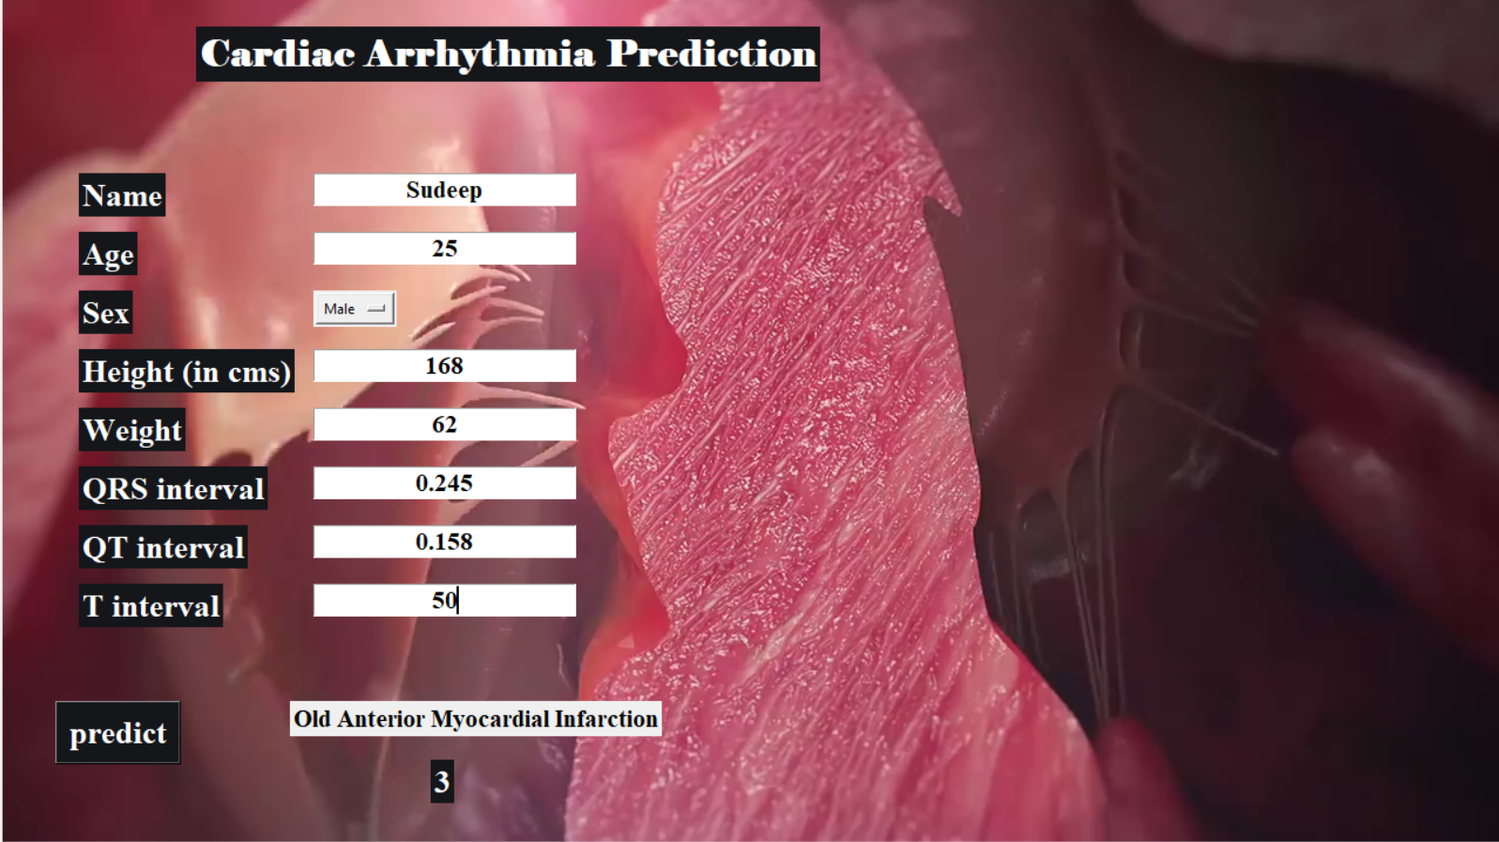
DAYANANDA SAGAR ACADEMY OF TECHNOLOGY & MANAGEMENT
(An Autonomous Institute under VTU)

Slide 18
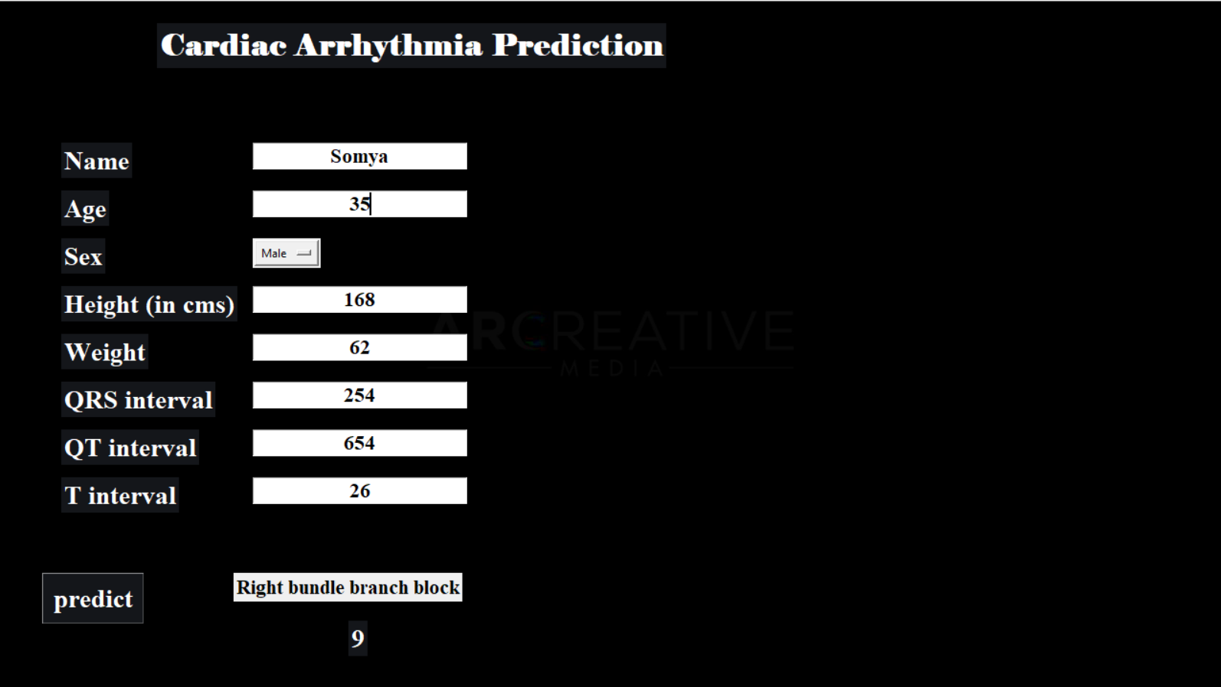
DAYANANDA SAGAR ACADEMY OF TECHNOLOGY & MANAGEMENT
(An Autonomous Institute under VTU)

Slide 19
DAYANANDA SAGAR ACADEMY OF TECHNOLOGY & MANAGEMENT
(An Autonomous Institute under VTU)
Conclusion:
The findings clearly imply that machine learning can aid in the identification of cardiac arrhythmias. It helps in the identification and prediction of cardiac arrhythmias.
The ability to detect cardiac arrhythmias at an early stage would allow for early intervention. The analysis is done using ML Techniques.
arrived at the conclusion that Weighted KNN is the best-suited ML Technique to Predict the type of Cardiac Arrhythmia.

Slide 20
DAYANANDA SAGAR ACADEMY OF TECHNOLOGY & MANAGEMENT
(An Autonomous Institute under VTU)
Bibliography:
[1] J. Smith, E. Johnson, and R. Lee, “Machine Learning Approaches for Cardiac Arrhythmia Detection,” Journal of Biomedical Engineering, vol. 45, no. 3, pp. 215–230, 2023.
[2] S. Thompson, M. Brown, and L. White, “Real-Time ECG Classification Using Deep Learning,” International Journal of Cardiology, vol. 150, no. 4, pp. 567–580, 2023.
[3] M. Taylor, J. Lee, and S. Chen, “Ensemble Learning for Cardiac Arrhythmia Detection,” Journal of Artificial Intelligence in Medicine, vol. 112, pp. 1–10, 2023..
[4] D. Green, A. Black, and K. Harris, “Hybrid Machine Learning Model for Arrhythmia Prediction,” Journal of Medical Systems, vol. 46, no. 2, pp. 1–12, 2022..
[5] Eko Ihsanto, Kalamullah Ramli, Dodi Sudiana and Teddy Surya Gunawan“An Efficient Algorithm for Cardiac Arrhythmia Classification Using Ensemble of Depth wise Separable Convolutional Neural Networks” Published on 9 January 2020

